Slide 1

Developing A Real Time Analytical System To Support Innovative Visualization Techniques For Crypto Currency Data
Jaskeerat Singh (47610039)

Slide 2

Introduction
The rapid advancement and widespread adoption of digital currency have transformed crypto into an alternative to traditional payment methods.
However, this surge in popularity has also attracted criminals seeking to exploit the system through legal loopholes, leading to market manipulation and Ponzi schemes.

Slide 3

To stop such activities, I propose a system that shows law enforcement agencies alerts on fraudulent transactions. This system would also visualize the sequence of transactions to their origin and help respond to financial cybercrimes.
The proposed solution will be a user-interactive system capable of detecting and visualizing fraudulent exchanges. These transactions will be visually represented within the complex network of Bitcoin exchanges and will help establish provenance or track the flow of money.

Slide 4
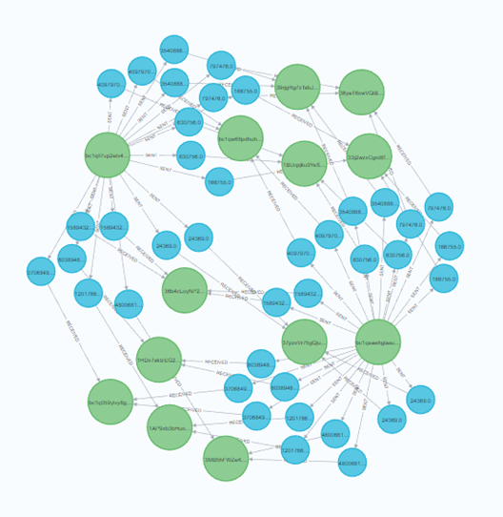
This project is a collaborative effort involving three other team members. My role includes developing an analytical system that encompasses data ingestion, data preprocessing, data storage in a graph database, fraud detection using unsupervised techniques, and connecting these programs using the defined API to enhance accessibility.
In this project, I am developing a real-time analytics application for this project that utilizes statistical analysis and unsupervised machine learning methods to generate alerts for identifying suspicious transactions.

Slide 5
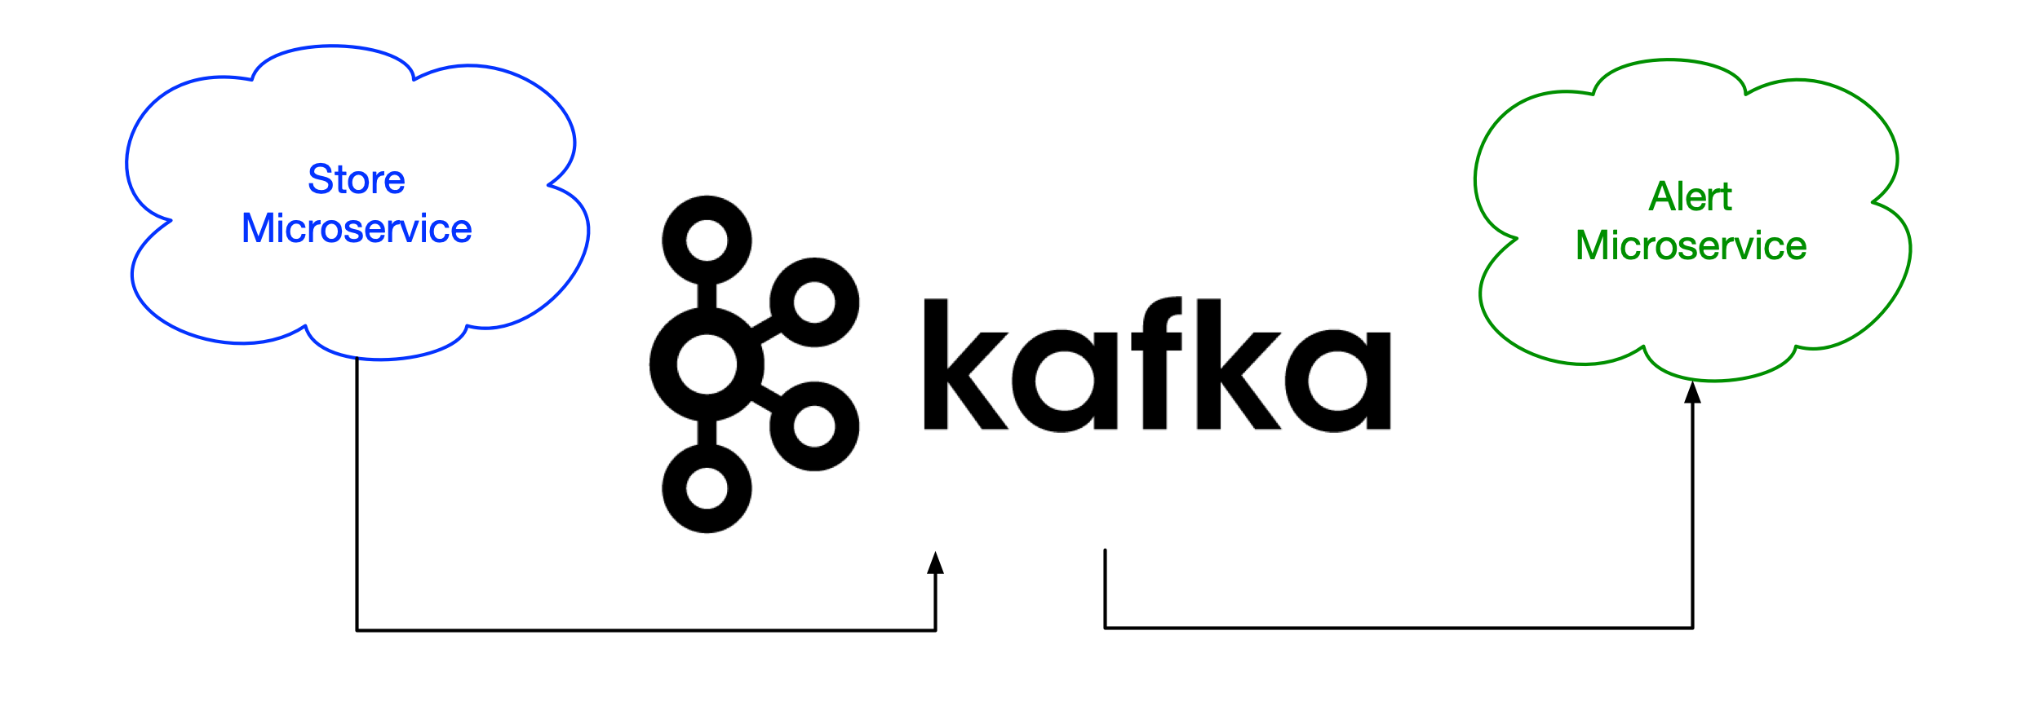
Goals
Implement a real-time system by developing a real-time analytical system utilizing MLOps methodologies and microservice architecture (loosely coupled).
Setup connection to real time streaming API using Kafka to generate data in batches.
Perform data cleaning and processing activities of incoming data, culminating in the storage of cleaned cleaned data within a graph database.

Slide 6
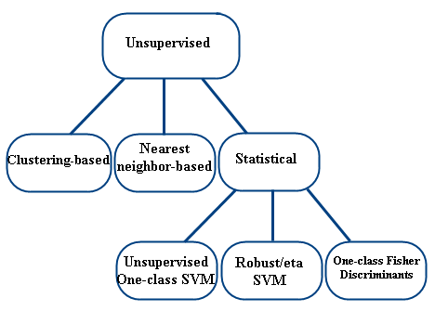
Select optimal statistical and unsupervised learning algorithm through experimentation, thus identifying the most suitable unsupervised learning algorithm and statistical methods for fraud detection.
Build an inter-connected system that arranges the application as a collection of loosely coupled, fine-grained services, communicating through lightweight protocols like API.

Slide 7
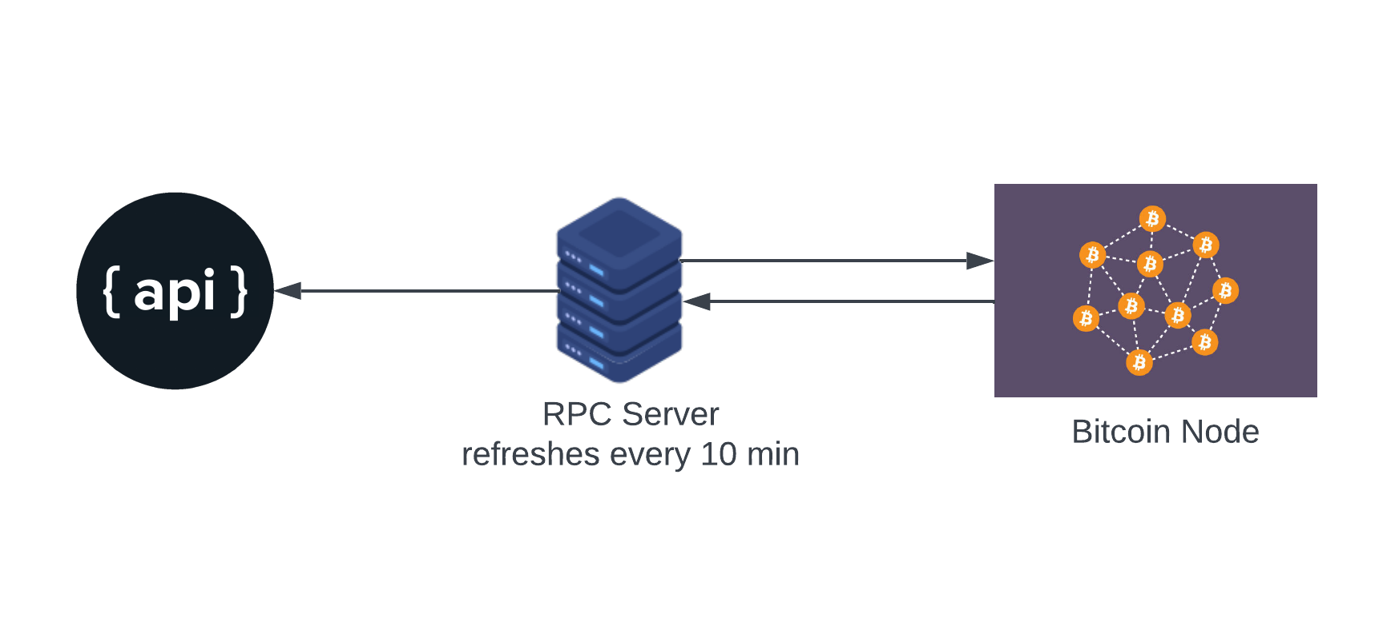
Data
In this project, I will use the data coming from a Bitcoin node.
I will call a defined API to retrieve the latest block data from the RPC server.
The data in the block is refreshed every 10 minutes.
The incoming data will be in JSON format and will consist of multiple records.

Slide 8
Representation of incoming record - {
"hash":"c3cd8af1183642478e082ddc1f861df088d5ce1b1cbd50875b379918691a4fc6",
"block_number":811222,
"block_hash":"0000000000000000000464f41d4ea87732b92001ce25c551a1b1633dea8b2f76",
"block_timestamp":1696768486,
"is_coinbase":false,
"index":1,
"inputs":[{
"index":0,
"spent_transaction_hash":"f20e13d6375a1d07c2176338467690aca2a5e297571e1f3626c579d9f94a5d28",
"spent_output_index":0,
"type":null,
"addresses":[],
"value":null}],
"outputs":[{"index":0, "addresses":["1PjxLx2kYtSF5urYn48srZmpuGH3iWdNCk"], "value":9920000}],
"input_count":1,
"output_count":1,
"input_value":0,
"output_value":9920000,
"fee":-9920000
}

Slide 9
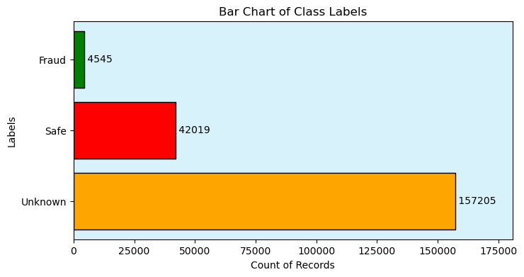
Problems and Solutions
Cryptocurrency transactions are typically anonymized, making labelled fraud data scarce. When available, the training data often exhibits high skewness (elliptical dataset).
If the training data is heavily skewed toward legitimate transactions or unavailable, attempting to balance (making record label same quantity) it using techniques like resampling or SMOTE may lead to a higher rate of false alerts for genuine transactions.

Slide 10
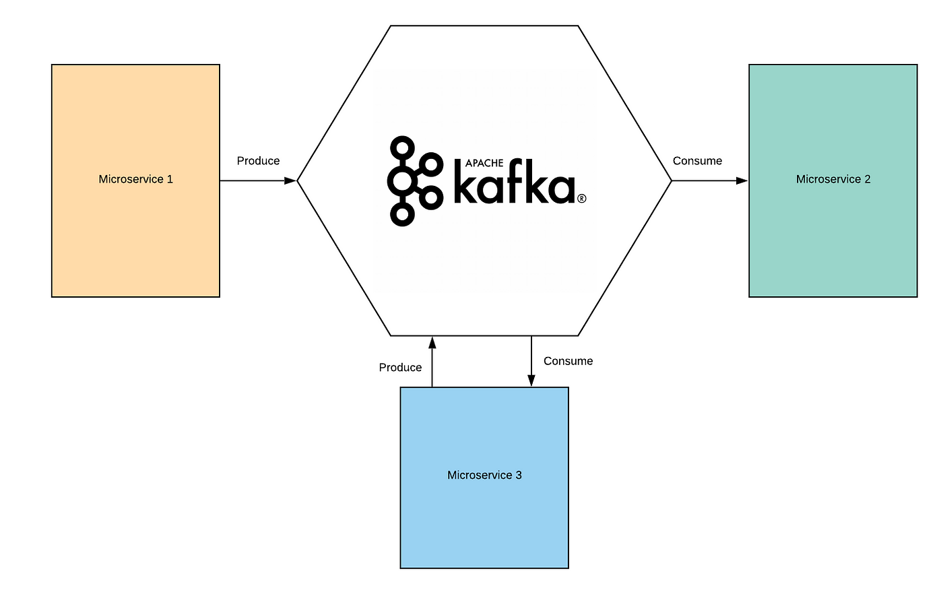
When establishing a real-time system capable of handling incoming data, it is essential to choose components that can operate autonomously and can be modified without disrupting other components as needed.
For this purpose, the 'KAFKA' publish-subscribe (pub-sub) method will be used to pass data between various programs in the system.

Slide 11
After pre processing and identification of fraudulent transactions, it is essential to choose a storage solution that takes advantage of the relationships among transaction addresses, supports real-time storage, and provides fast query responses.
Aspect | Graph Database | Relational Database
Data Structure | Uses a graph data model with nodes and edges to represent relationships. | Utilizes tables with rows and columns to store structured data.
Schema Flexibility | Offers schema flexibility, allowing for dynamic changes to the data structure. | Requires a predefined and rigid schema that enforces data consistency and structure.
Relationship Handling | Excellently suited for managing and querying complex relationships between data points. | Capable of handling relationships, but joins and foreign keys can make complex relationships more challenging to query.
Performance | Performs exceptionally well for highly interconnected data, such as social networks and recommendation engines. | Typically excels at handling structured data and performing traditional SQL queries efficiently.
Use Cases | Ideal for scenarios with data that has complex, many-to-many relationships, such as social networks and fraud detection. | Well-suited for transactional systems, reporting, and applications with well-defined schemas, like financial systems and inventory management.

Slide 12
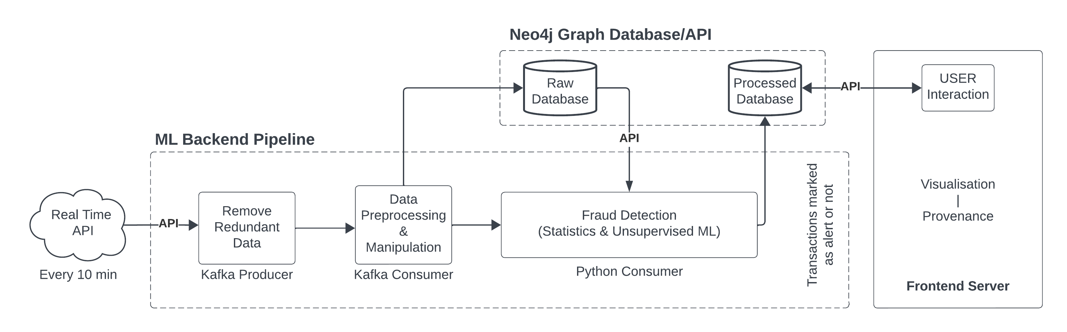
Proposed Solution
The proposed application comprises four distinct components, each dedicated to a specific task. These programs include:
Real-time data/Kafka producer.
Data cleaning and preprocessing module.
Statistical analysis and machine learning for fraud detection.
API for querying the graph database for visualization.
Each of these components will be loosely connected using the defined API.

Slide 13
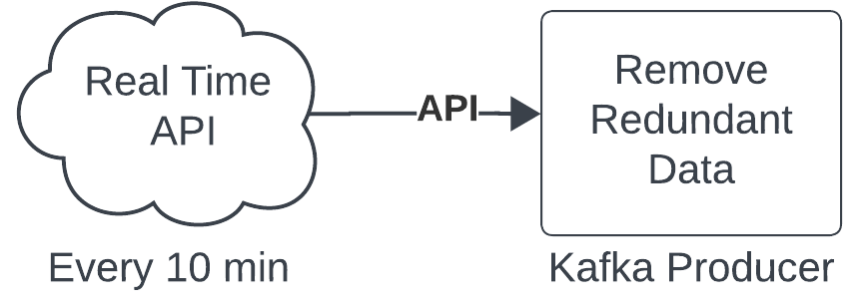
Real time data/Kafka producer
Using the local API to retrieve updated data in batches every 10 minutes.
The incoming data block will be checked to remove duplicate data blocks.
After consuming the data, redundant rows will be removed.
A Kafka topic will be created to transmit records for data preprocessing and manipulation.

Slide 14
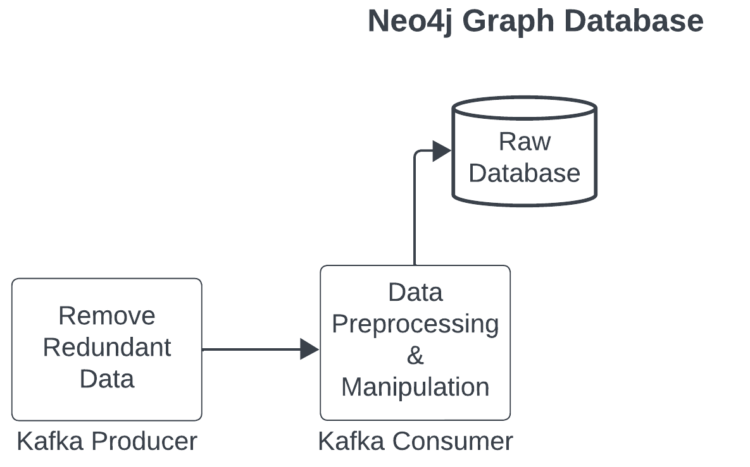
Data preprocessing and manipulation
Read incoming data from Kafka topic.
Apply preprocessing techniques such as imputation in place of null values, standardization, and data transformation.
After the data has been cleaned, perform data type processing before pushing the data into the Neo4j graph database.

Slide 15
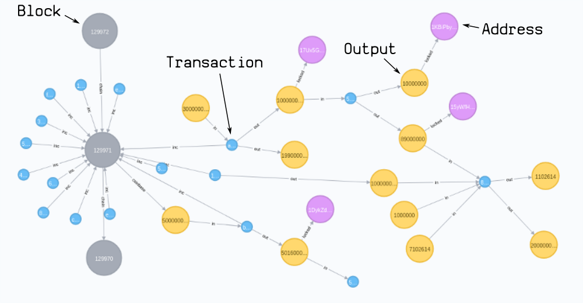
Representation of Transactions

Slide 16
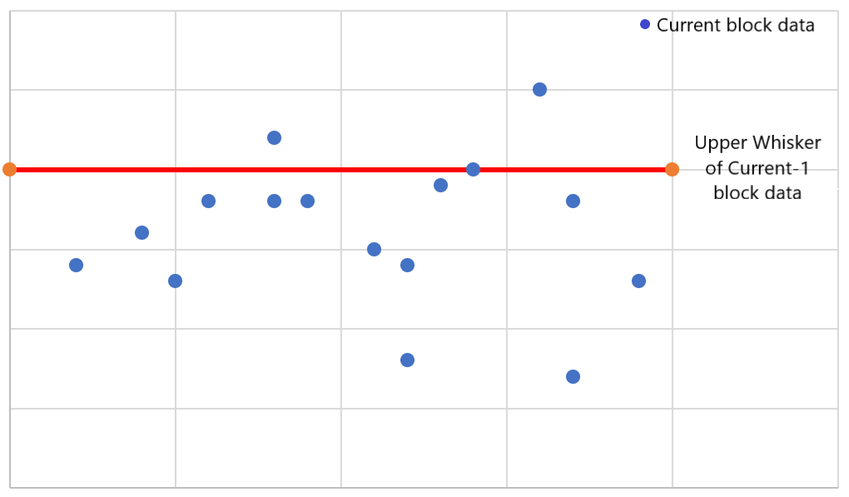
Statistical analysis and machine learning
After the pre-processing techniques have been applied to the incoming data, statistical methods for anomaly detection will be implemented to flag transactions as safe or fraudulent.
Point outliers represent records that significantly deviate from the moving upper whisker value of the current-1 block data. The value of the latest transactions will be compared to the average value of the last block. Transactions with significant deviation will be flagged as fraudulent.
upper whisker

Slide 17
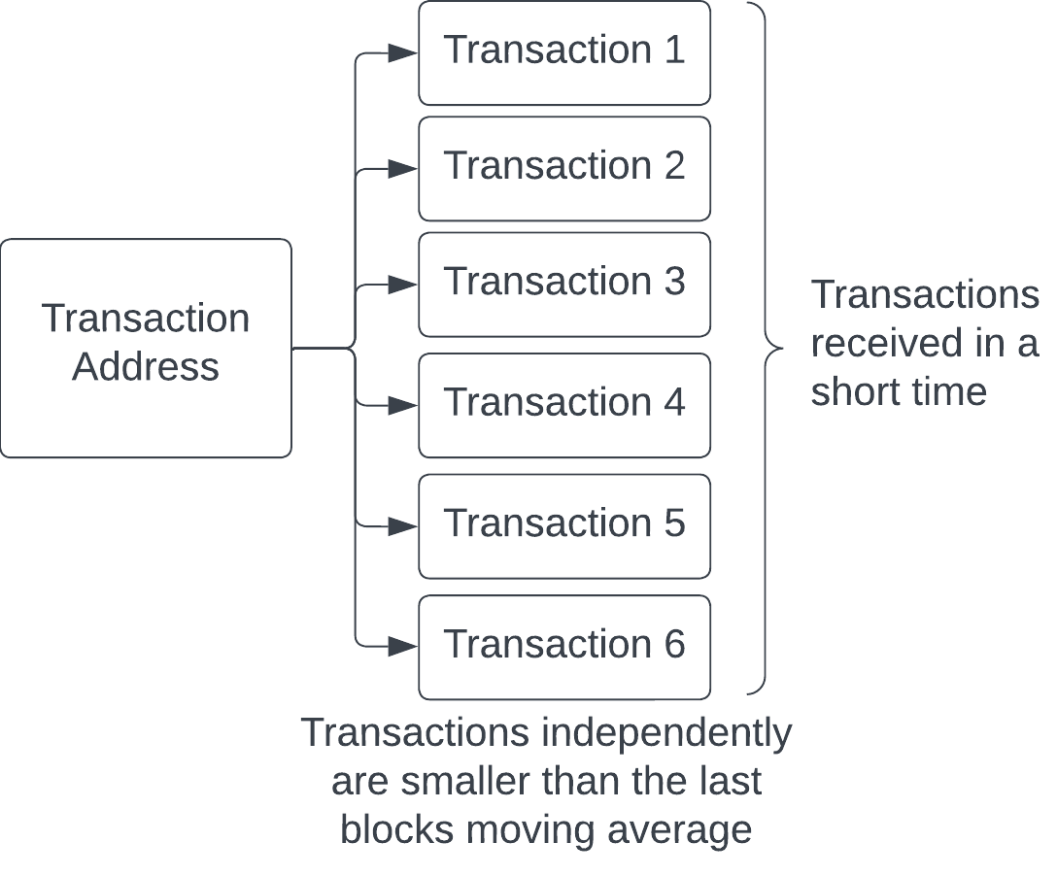
Multivariate collective outliers are used to catch anomalies that result from the combined effects of variables (in this case, value of transaction).
For instance, an address performing multiple low-value transactions that are not caught using point anomaly detection but a large number of transactions might collectively constitute an anomaly, even if each variable falls within the normal range when considered individually.

Slide 18
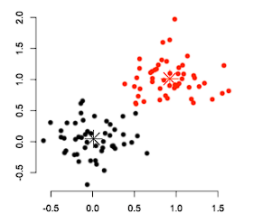
Machine Learning K-means clustering
K-means clustering is a technique employed in transactional fraud detection to group similar transactions based on their defined features.
These features can be extracted from Neo4j graph database in the form of centrality measures and node embeddings.
Through K-means, transactions are divided into distinct clusters, and then anomalies are detected that notably diverge from the expected patterns within the clusters.
Anomaly detection unsupervised methods such as Local Outlier Factor (LOF) computes the local density deviation of a given data point with respect to its neighbors. This helps to uncover nodes that diverge from the surrounding graph structure.

Slide 19
API for querying the graph database
The API will be used to build a loosely coupled architecture.
This API will allow individual components to call and retrieve data from the backend Neo4j graph database.
Separate routes are defined for obtaining data from the cleaned or processed database and for managing the order of provenance flow.
@app.get("/") returns "Welcome to Neo4j“, allowing user to check connection with API
@app.get("/neo4j_cleaned") returns data from clean schema of bitcoin database
@app.get("/neo4j_unsupervised") returns data from processed schema with alerts of bitcoin database
@app.post("/provenance") return list of connections between transactions

Slide 20
Conclusion
With this system, I believe that the needs of the stakeholders (law enforcement agents) to build a provenance flow will be satisfied.
This system will analyze the data in real time to provide alerts.
This analytical system also gives users the ability to view the desired group of transactions to form a provenance flow through the use of an API.
The loosely coupled architecture gives researchers the ability to modify and upgrade the system in the future without much difficulty.

Slide 21


Slide 22
References
Vijay Yadav. (n.d.). https://blogs.quickheal.com/blockchain-fraud-prevention-strategies-to-overcome-the-cryptocurrency-scam/. https://blogs.quickheal.com/wp-content/uploads/2021/09/Cryptocurrency-Fraud-What-you-should-know-and-how-to-avoid-them.jpg
Rob Curran. (n.d.). https://money.com/popular-crypto-scams-2022/. https://img.money.com/2022/01/Investing-Avoid-Crypto-Scams.jpg?quality=60&w=1600
Jimena Garbarino. (n.d.). https://developer.okta.com/blog/2022/09/15/kafka-microservices. https://developer.okta.com/assets-jekyll/blog/kafka-microservices/kafka-microservices-1ef916f3bff9b1ae67d1a861454016f2093114005c60d8e3a53cc40371cb1167.png
Mohammadreza Ebrahimi. (n.d.). https://www.researchgate.net/figure/Position-of-Semi-supervised-and-SVM-based-techniques-in-the-taxonomy-of-anomaly-detection_fig2_312541389. https://www.researchgate.net/profile/Mohammadreza-Ebrahimi-2/publication/312541389/figure/fig2/AS:766906139164673@1559856080342/Position-of-Semi-supervised-and-SVM-based-techniques-in-the-taxonomy-of-anomaly-detection.ppm
Anam Hossain. (n.d.). https://engineering.carsguide.com.au/laravel-pub-sub-messaging-with-apache-kafka-3b27ed1ee5e8. https://miro.medium.com/v2/resize:fit:828/format:webp/1*BcQtXba5H71397j6MJPFqg.png
Greg Walker. (n.d.). https://neo4j.com/blog/import-bitcoin-blockchain-neo4j/. https://dist.neo4j.com/wp-content/uploads/20180109030108/neo4j-bitcoin.png
Vishal Agarwal. (n.d.). https://medium.com/@agarwal.vishal819/outlier-detection-with-boxplots-1b6757fafa21. https://miro.medium.com/v2/resize:fit:828/format:webp/1*0MPDTLn8KoLApoFvI0P2vQ.png
ZACH. (n.d.). https://www.statology.org/horizontal-line-scatterplot-excel/. https://www.statology.org/wp-content/uploads/2021/03/horizontalExcel7-768x560.png
K. Amarasinghe, K. Kenney and M. Manic, "Toward Explainable Deep Neural Network Based Anomaly Detection," 2018 11th International Conference on Human System Interaction (HSI), Gdansk, Poland, 2018, pp. 311-317, doi: 10.1109/HSI.2018.8430788.
(n.d.). https://www.pinclipart.com/maxpin/oxihRw/. https://www.pinclipart.com/picdir/big/175-1758555_empower-your-city-policing-principled-clipart.png

